Slide 1
Spectral Problems

Slide 2
NMR Spectral Problems:
Number of signals – Information on symmetry
Nature of the peak – Information on relaxation/hydrogen bonding
Splitting pattern (multiplicity) – Neighboring group
Integral values – Number of protons or proton ratios
Chemical Shift – Local environment around the proton
Coupling constant – Geometrical position of coupling partner
Solving structure of molecules

Slide 3
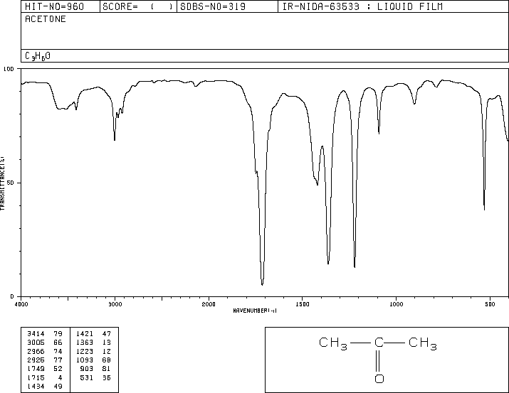
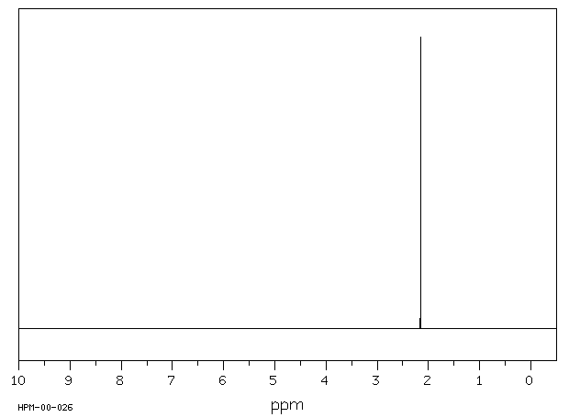
3005
1715
C₃H₆O

Slide 4
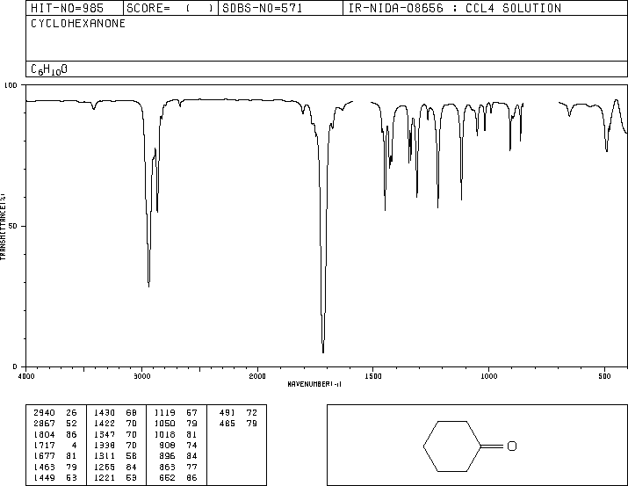
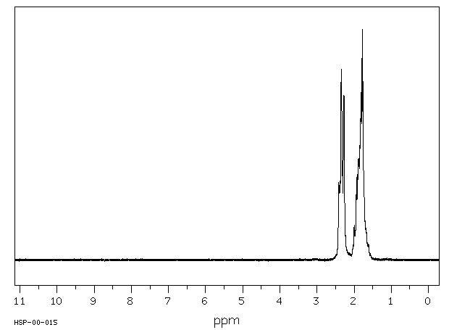
6
4
2940
1717
C₆H₁₀O

Slide 5
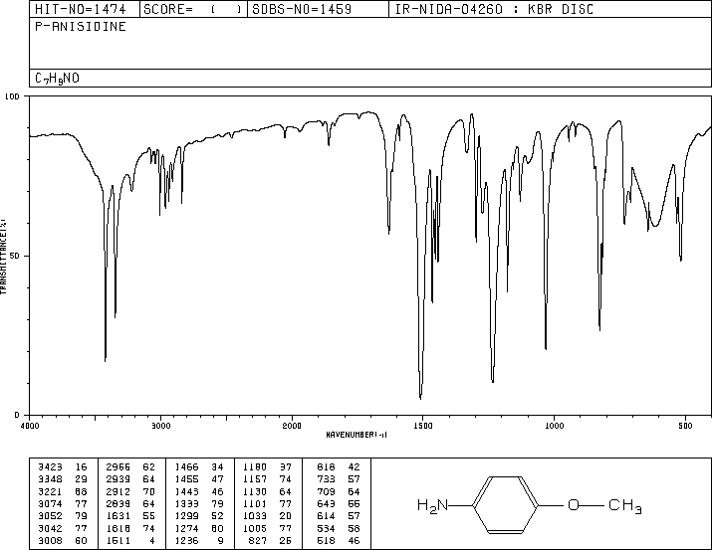
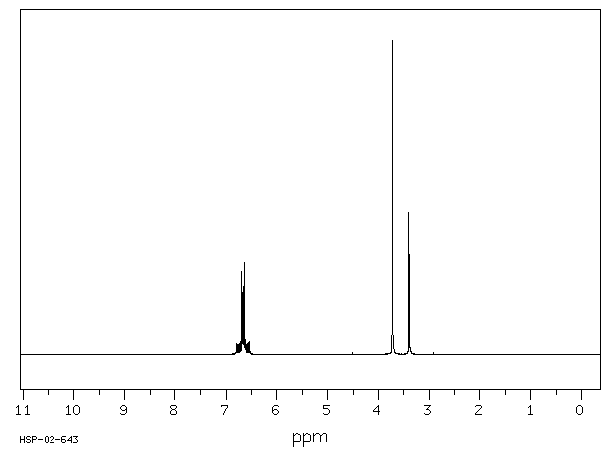
3
2912
2
3074
3052
4
3348
3423
C₇H₉NO

Slide 6
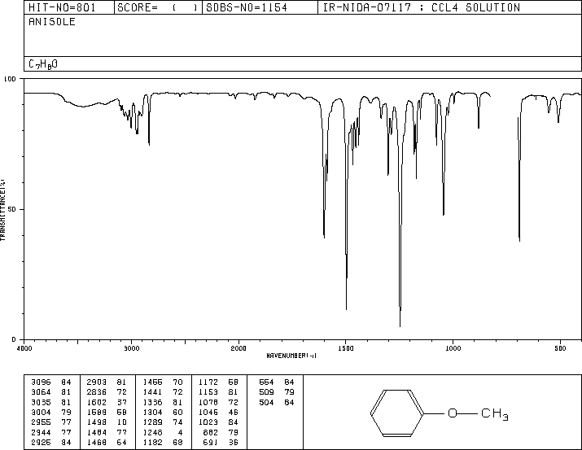
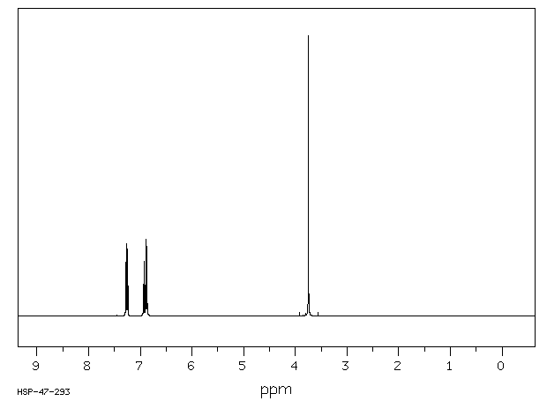
3
3096
3064
3055
2836
1602
2
3
C₇H₈O

Slide 7
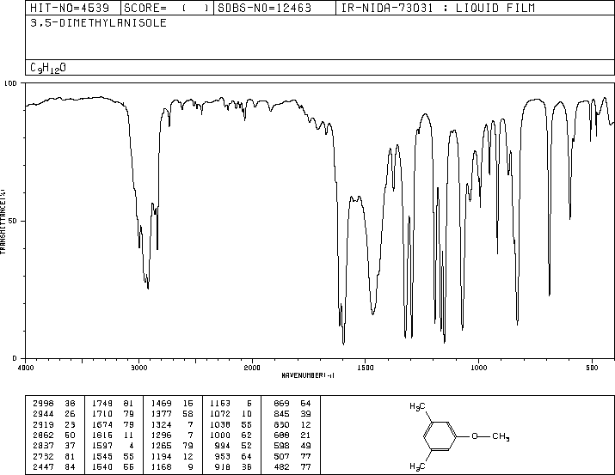
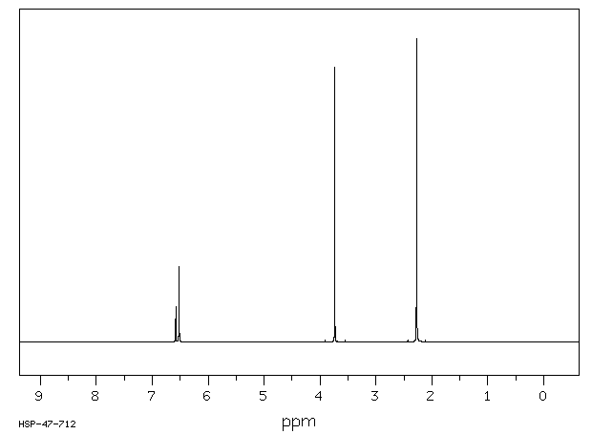
6
3
2
1
1597
C₉H₁₂O

Slide 8
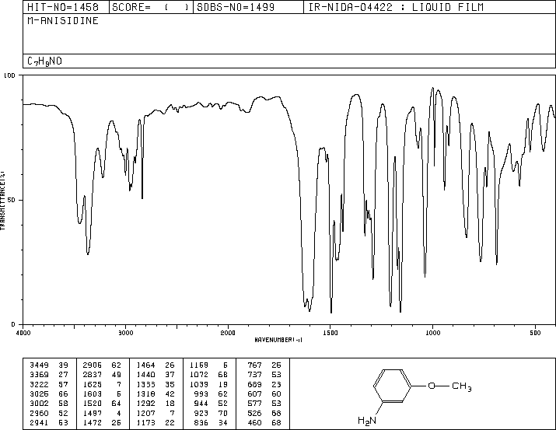
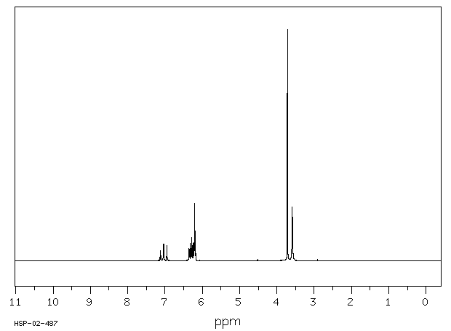
3
1
2
1
2
C₇H₉NO

Slide 9
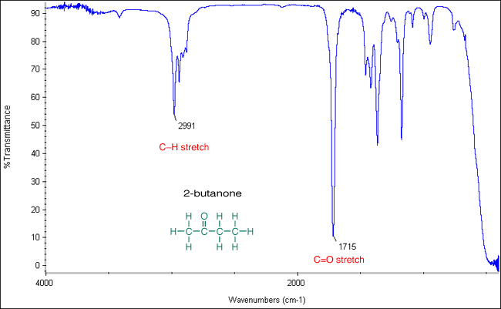
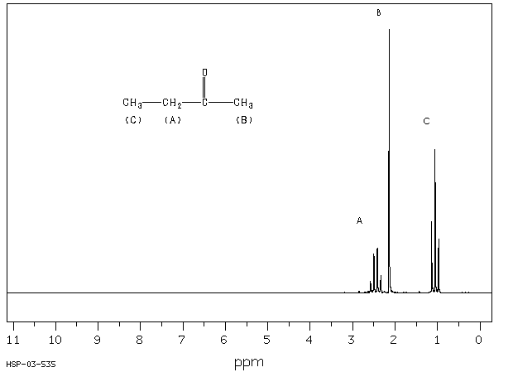
1173
1366
C₄H₈O

Slide 10
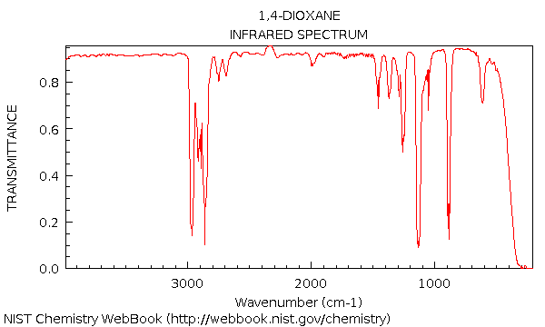
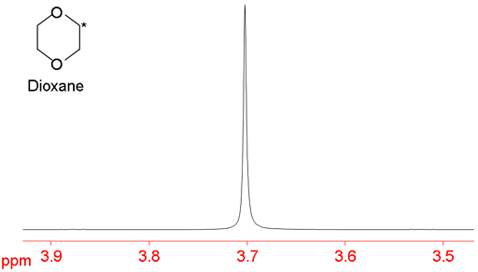
C₄H₈O₂

Slide 11
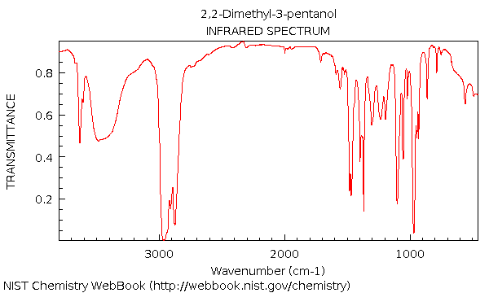
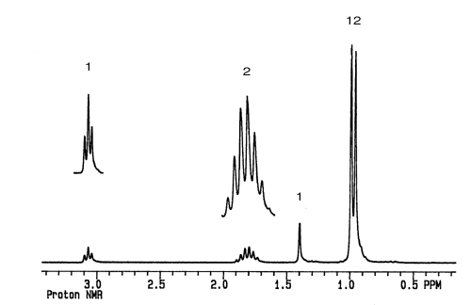
C₇H₁₆O

Slide 12
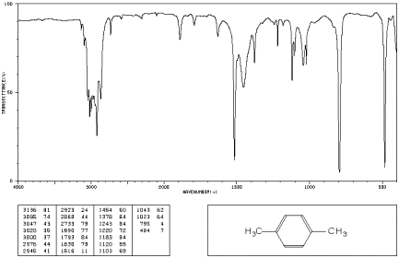
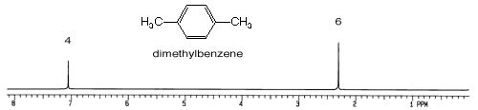
C₈H₁₀

Slide 13
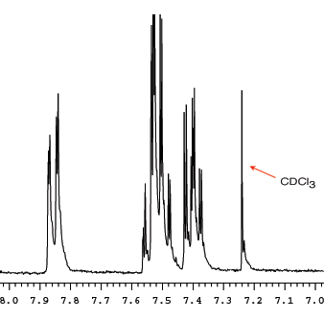
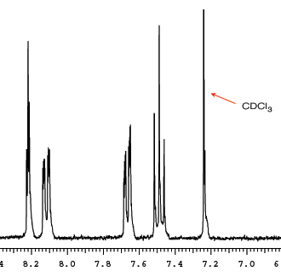
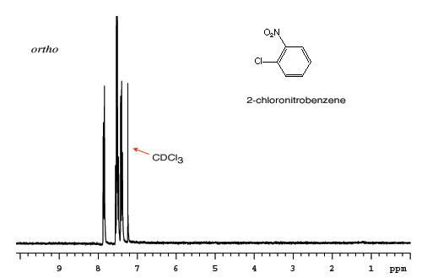
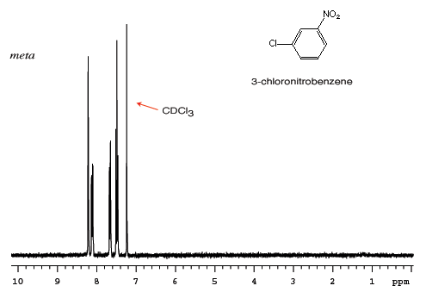
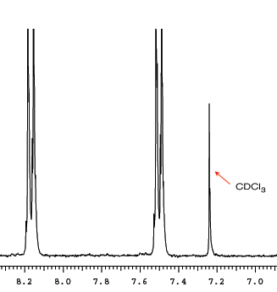
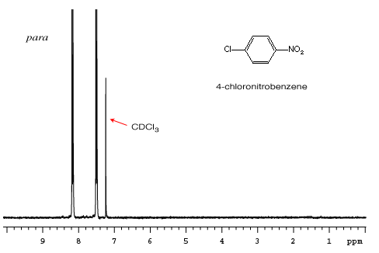
C₆H₄ClNO₂

